Slide 1
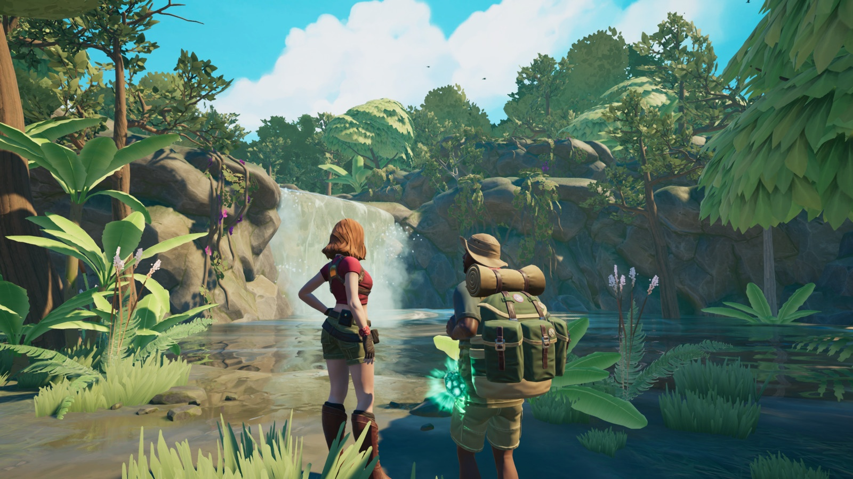
Wanderer 3D Game
DENİZ BOZKAN - 20190808044
DAMLA HATİCE ŞİMŞEK - 20180808067
BÜŞRA SARIGEYİK - 2018080847

Slide 2
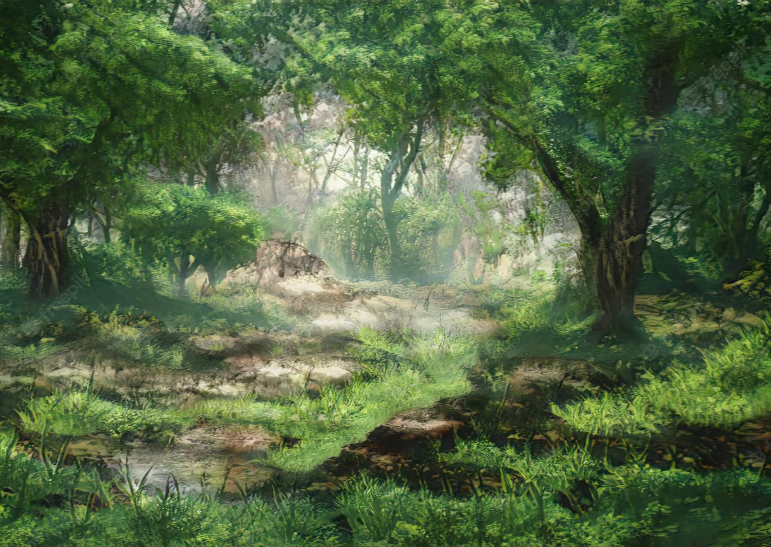
Our Inspiration
Our main goal was to make games like the ones we played as children. We could go to different worlds and experience different games.
We wanted a world that we can change the environment, our inspiration for that was the world. In real world we cannot see different environments easily we have to take some miles to get there.

Slide 3
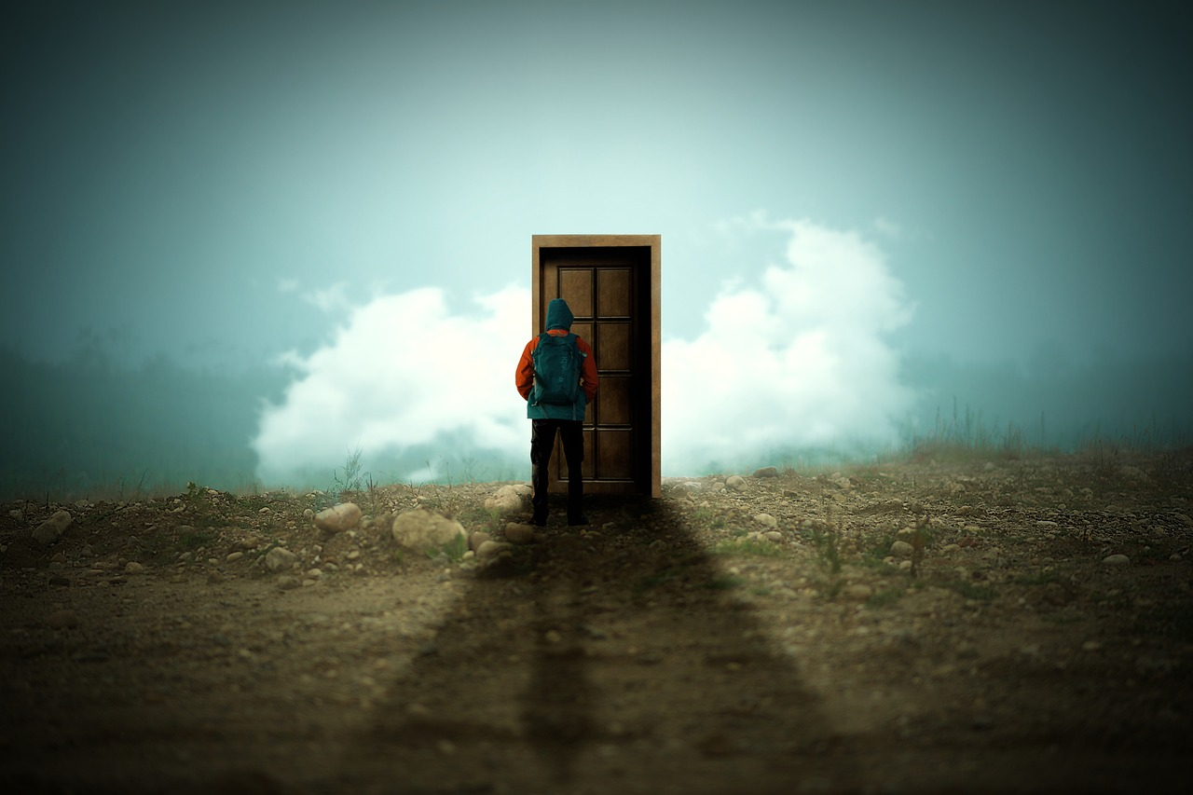
What it does?
So we wanted to visit different places in our game. You can see different worlds in our game and have fun with the games.
There are different universes and different games. Our character has to wander around the universe and find the playgrounds hidden there. We added doors to pass along the universes.

Slide 4

What it does?
Player has to find the doors in the map and with touching it, player can enter a different world. Player can play the games with touching the doors as well. We add two different game so some doors opens these games.
In our first game player has to pass the levels and earn the tokens. You have to jump on the tokens to earn them and you have to pass some barriers. In our second game alsı player has to pass the levels. In this game there is a ball and player have to move it without falling down.

Slide 5
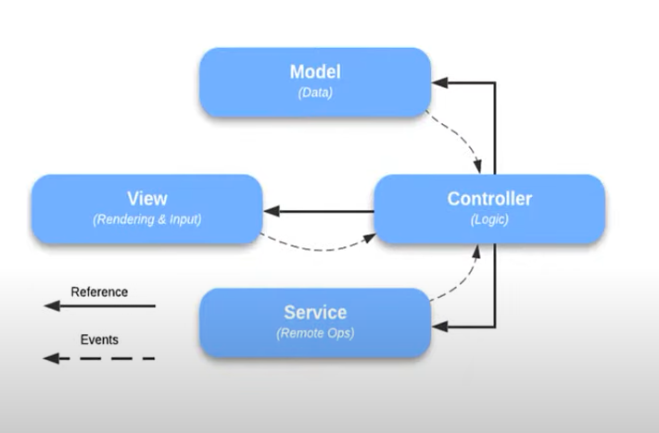
Architecture

Slide 6

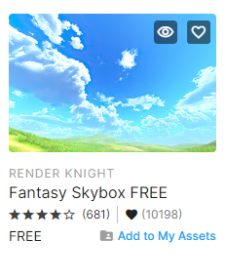
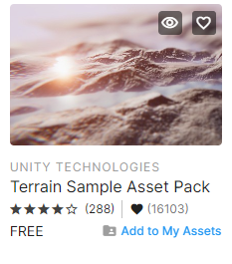
How we build it?
We use many assets to develop and design our game.
We created two different terrains and designed them with assets. Such as Fantasy Skybox FREE, Terrain Sample Assets.

Slide 7
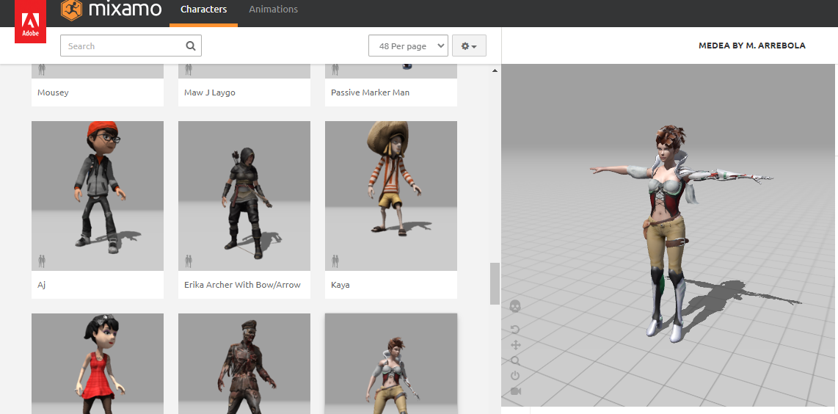
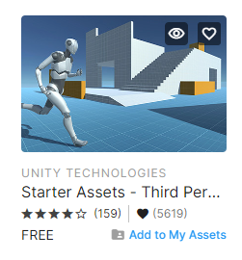
How we build it?
We used the Starter Asset for third person controller camera and player. It had many available features such as animations for the avatar. It was very useful.
We used mixamo for the avatar.

Slide 8
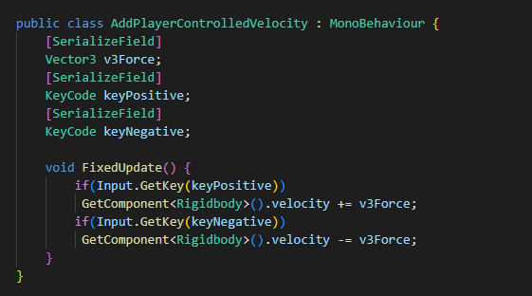
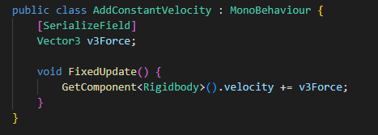
Code Examples
With these methods we can determine the velocity of the player.

Slide 9
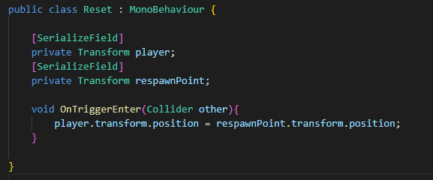
Code Examples
This class used for reseting the game. When playes falls down from platform it goes to starting point of the game so it resets the game.

Slide 10
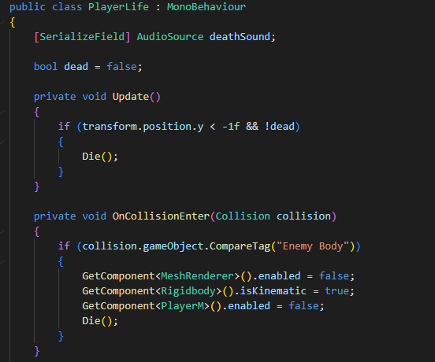
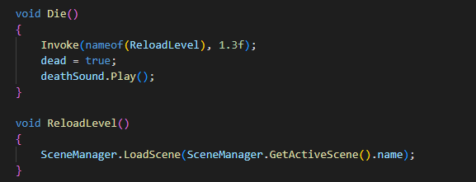
Code Examples
In this class we determine the conditions that player is dead.

Slide 11
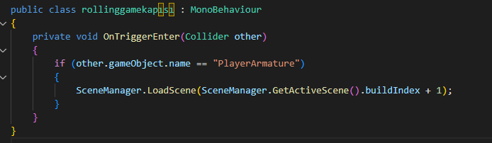
Code Examples
With this class we can pass through the door and change to the rolling game scene.

Slide 12

Let's look at the demo together!

